Slide 1
Some Thoughts About Particle Physics and QFT
C. Schiff – 4/25/17

Slide 2
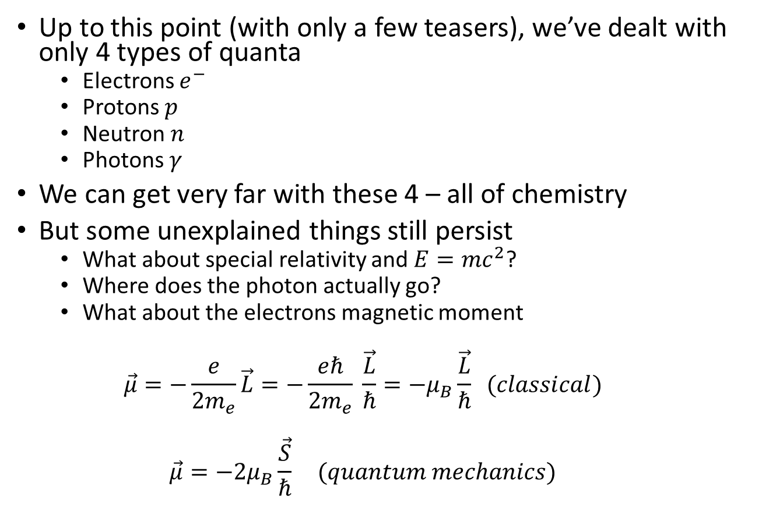
Ongoing mystery?
Up to this point (with only a few teasers), we’ve dealt with only 4 types of quanta
Electrons $e^{−}$
Protons $p$
Neutron $n$
Photons $γ$
We can get very far with these 4 – all of chemistry
But some unexplained things still persist
What about special relativity and $E=mc^{2}$?
Where does the photon actually go?
What about the electrons magnetic moment
$$\vec{μ}=−\frac{e}{2m_{e}}\vec{L}=−\frac{eℏ}{2m_{e}} \frac{\vec{L}}{ℏ}=−μ_{B}\frac{\vec{L}}{ℏ} (classical)$$
$$\vec{μ}=−2μ_{B}\frac{\vec{S}}{ℏ} (quantum mechanics)$$

Slide 3
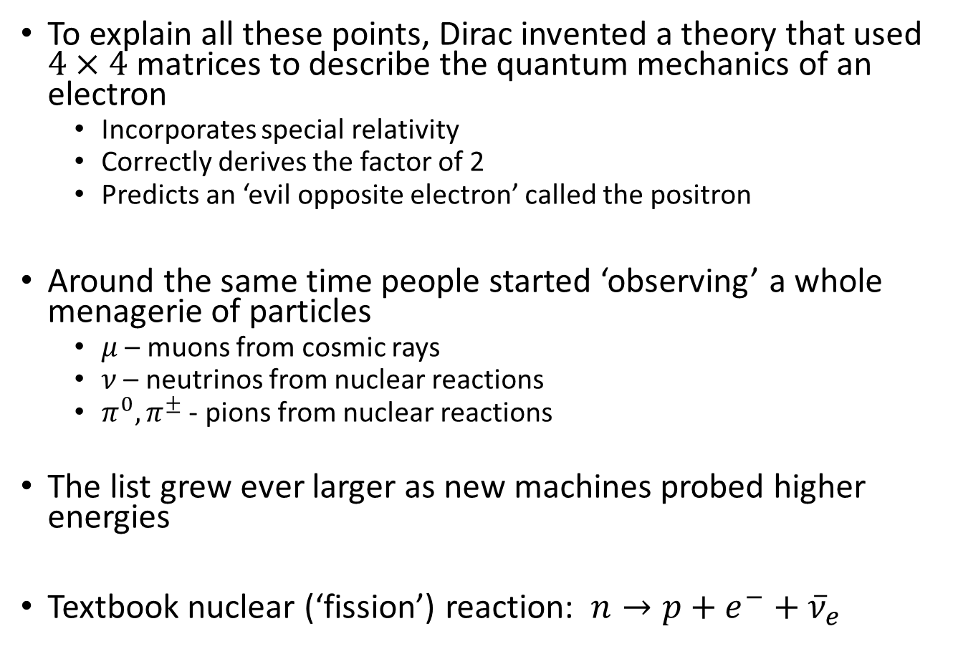
Who Ordered That?
To explain all these points, Dirac invented a theory that used $4×4$ matrices to describe the quantum mechanics of an electron
Incorporates special relativity
Correctly derives the factor of 2
Predicts an ‘evil opposite electron’ called the positron
Around the same time people started ‘observing’ a whole menagerie of particles
$μ$ – muons from cosmic rays
$ν$ – neutrinos from nuclear reactions
$π^{0},π^{±}$ - pions from nuclear reactions
The list grew ever larger as new machines probed higher energies
Textbook nuclear (‘fission’) reaction: $n→p+e^{−}+{\overline{ν}}_{e}$

Slide 4
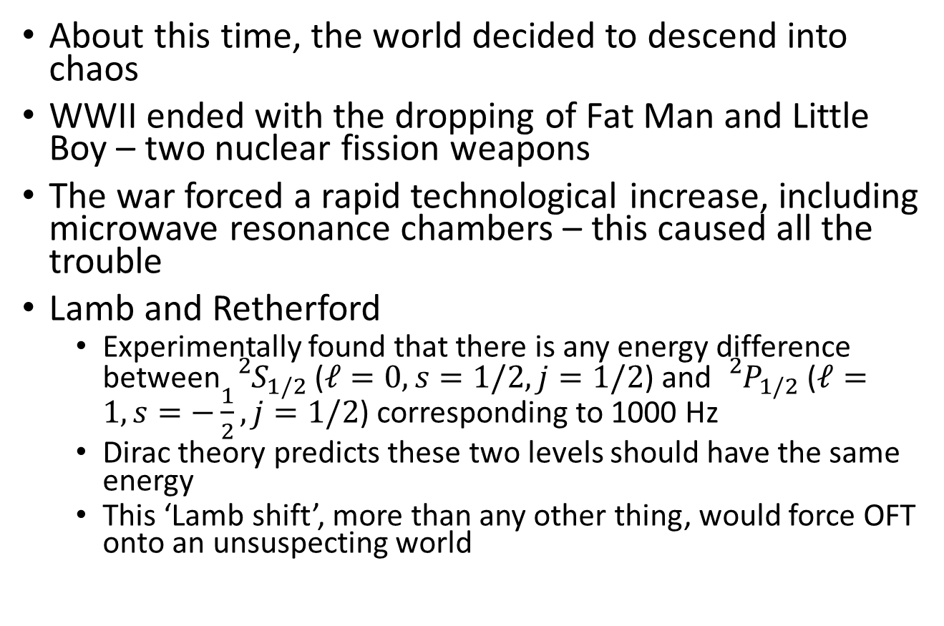
World War II Gets in the Way
About this time, the world decided to descend into chaos
WWII ended with the dropping of Fat Man and Little Boy – two nuclear fission weapons
The war forced a rapid technological increase, including microwave resonance chambers – this caused all the trouble
Lamb and Retherford
Experimentally found that there is any energy difference between ${}_{}^{2}{S_{1/2}}$ ($ℓ=0,s=1/2, j=1/2$) and ${}_{}^{2}{P_{1/2}}$ ($ℓ=1, s=−\frac{1}{2},j=1/2$) corresponding to 1000 Hz
Dirac theory predicts these two levels should have the same energy
This ‘Lamb shift’, more than any other thing, would force OFT onto an unsuspecting world

Slide 5
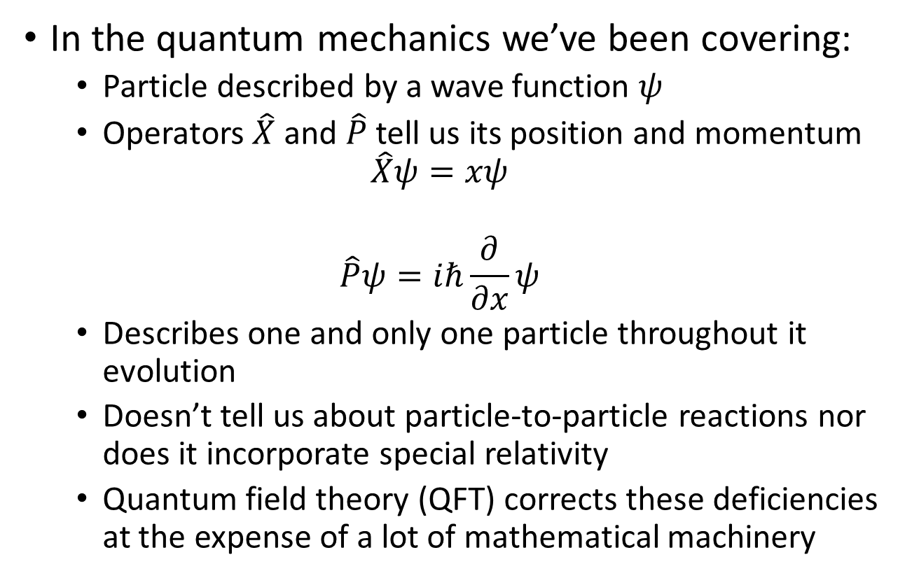
Everyone Talks About QFT But Nobody Says What It Is (1/2)
In the quantum mechanics we’ve been covering:
Particle described by a wave function $ψ$
Operators $\hat{X}$ and $\hat{P}$ tell us its position and momentum
$$\hat{X}ψ=xψ$$
$$\hat{P}ψ=iℏ\frac{∂}{∂x}ψ$$
Describes one and only one particle throughout it evolution
Doesn’t tell us about particle-to-particle reactions nor does it incorporate special relativity
Quantum field theory (QFT) corrects these deficiencies at the expense of a lot of mathematical machinery

Slide 6
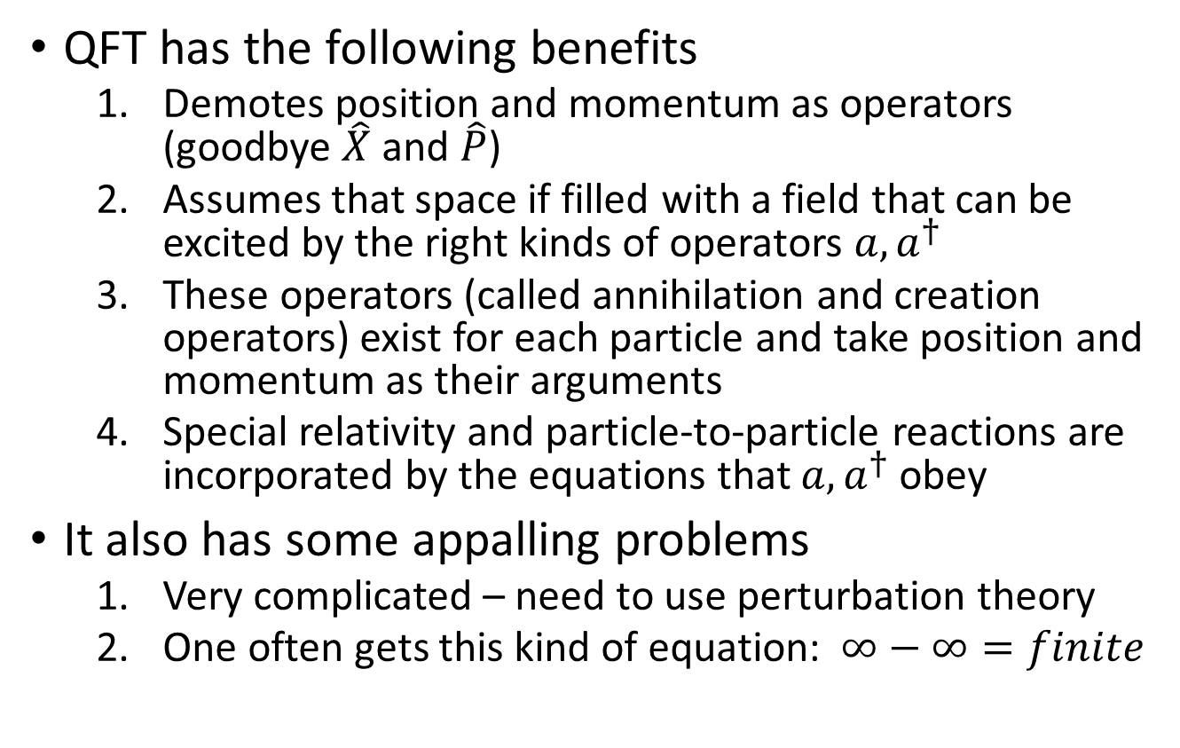
Everyone Talks About QFT But Nobody Says What It Is (2/2)
QFT has the following benefits
Demotes position and momentum as operators (goodbye $\hat{X}$ and $\hat{P}$)
Assumes that space if filled with a field that can be excited by the right kinds of operators $a,a^{†}$
These operators (called annihilation and creation operators) exist for each particle and take position and momentum as their arguments
Special relativity and particle-to-particle reactions are incorporated by the equations that $a,a^{†}$ obey
It also has some appalling problems
Very complicated – need to use perturbation theory
One often gets this kind of equation: $∞−∞=finite$

Slide 7
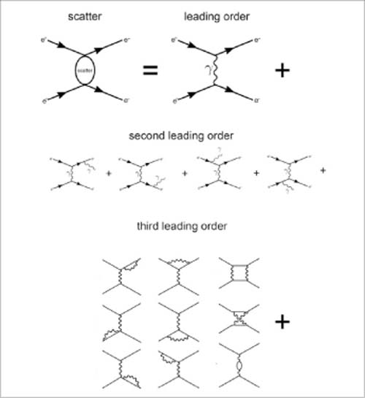
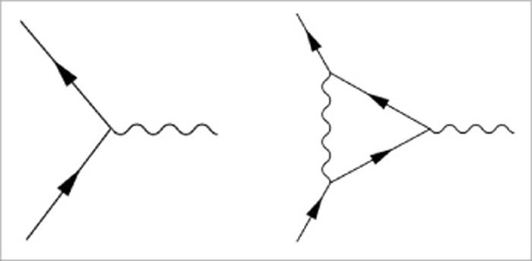
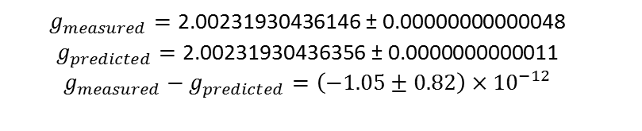
Perturbation Theory and Feynman Diagrams
Feynman came up with a pictorial representation of the perturbation theory
Fig. 5. The scattering of two real electrons can be approximated as a series of ever more complex emission patterns. By factorizing the calculation in this way, one can employ perturbation theory to approximate the calculation, and the calculation can be performed to an arbitrary level of precision by including the required number of terms. The relevant expansion variable is determined by the number of vertices with the absorption or emission of a photon, e.g., two in leading order, three in second leading order, four in third leading order, and so on.
$g_{measured}=\text{2.00231930436146 }\text{±}\text{ 0.00000000000048}$ $$g_{predicted}=\text{2.00231930436356 }\text{±}\text{ 0.0000000000011}$$ $$g_{measured}−g_{predicted}=\left(−1.05±0.82\right)×{10}^{−12}$$
Published in: Don Lincoln; The Physics Teacher 2016, 54, 203-208.
DOI: 10.1119/1.4944357
Copyright © 2016 American Association of Physics Teachers

Slide 8
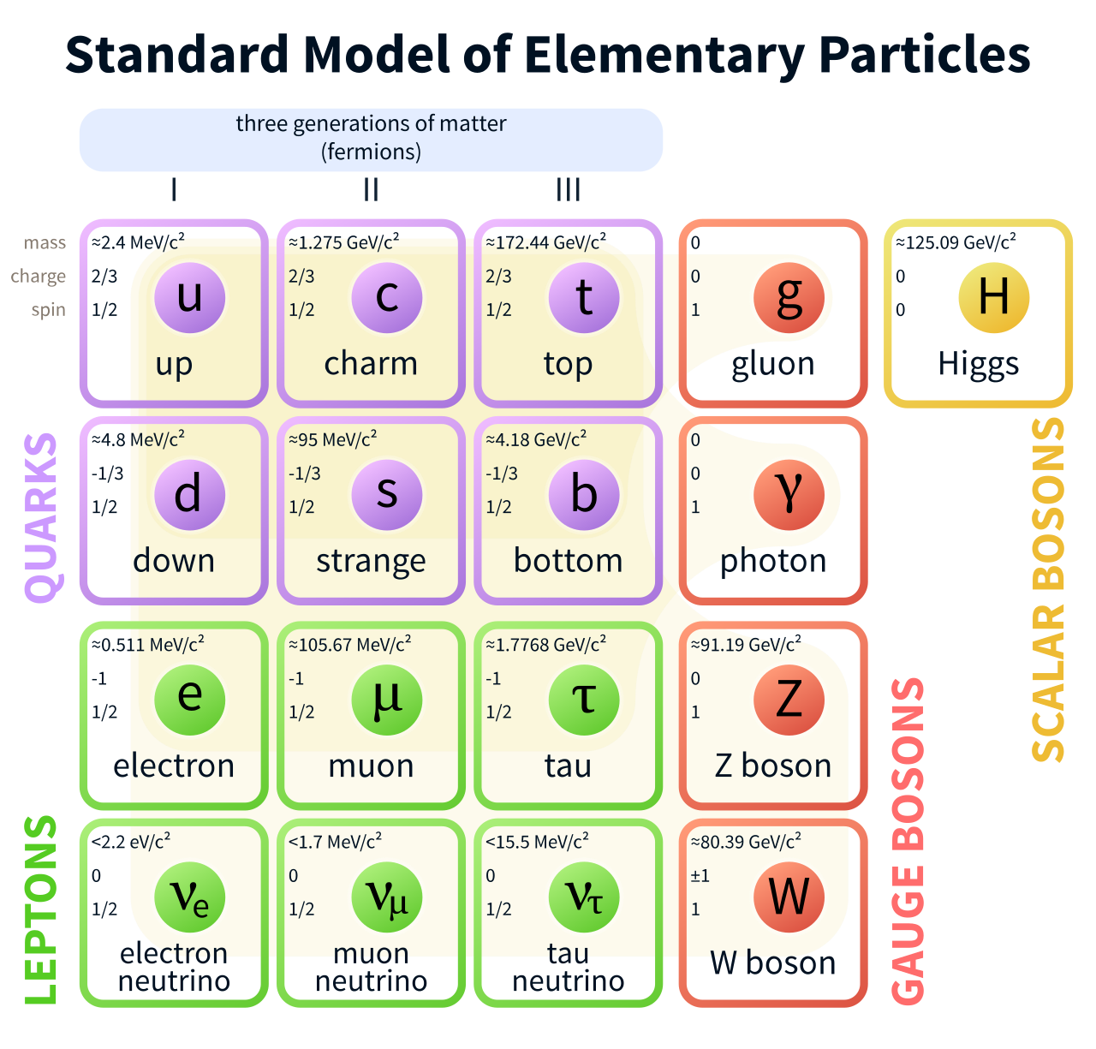
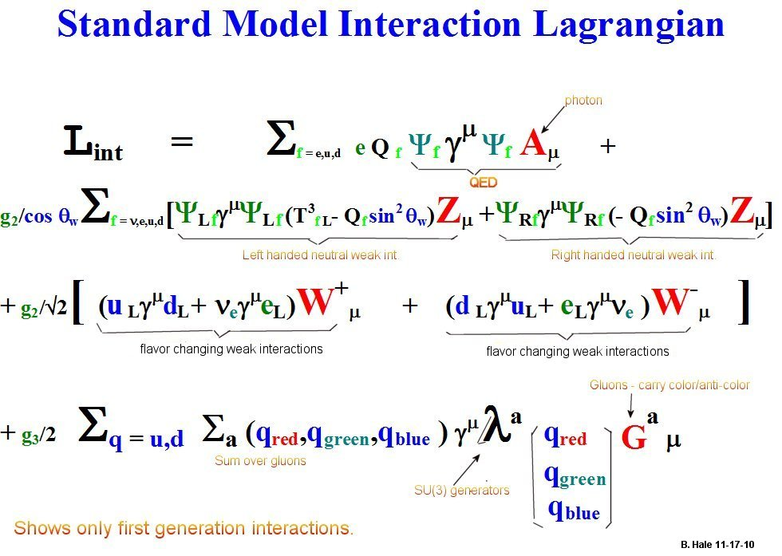
Standard Model
Modern view is the standard model
3 forces (E&M, Weak, and Strong)
Two types of fermions (leptons and quarks)
One Higgs boson

Slide 9
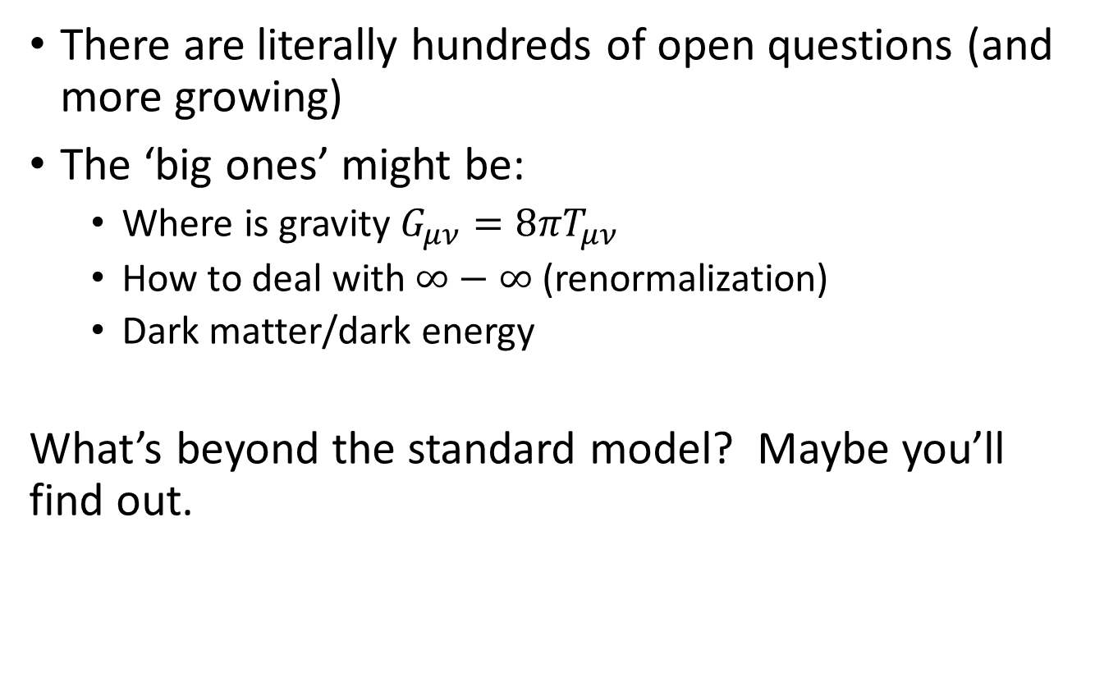
What’s Next
There are literally hundreds of open questions (and more growing)
The ‘big ones’ might be:
Where is gravity $G_{μν}=8πT_{μν}$
How to deal with $∞−∞$ (renormalization)
Dark matter/dark energy
What’s beyond the standard model? Maybe you’ll find out.

